Slide 1


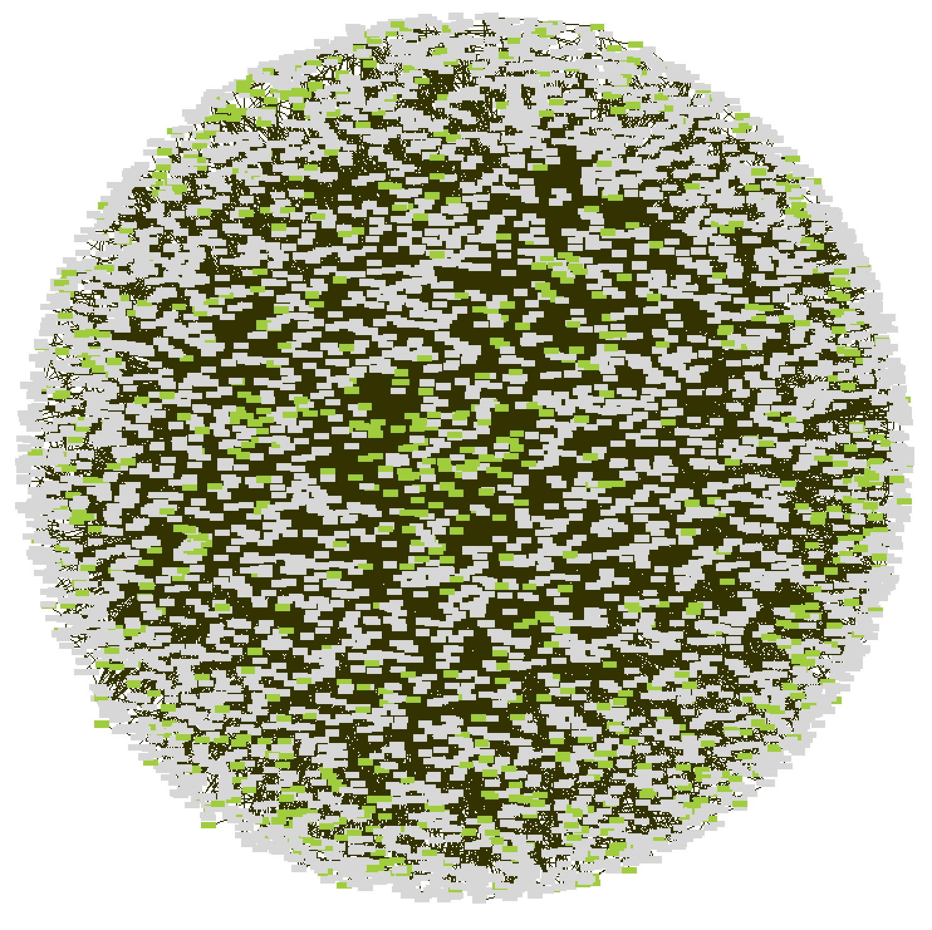

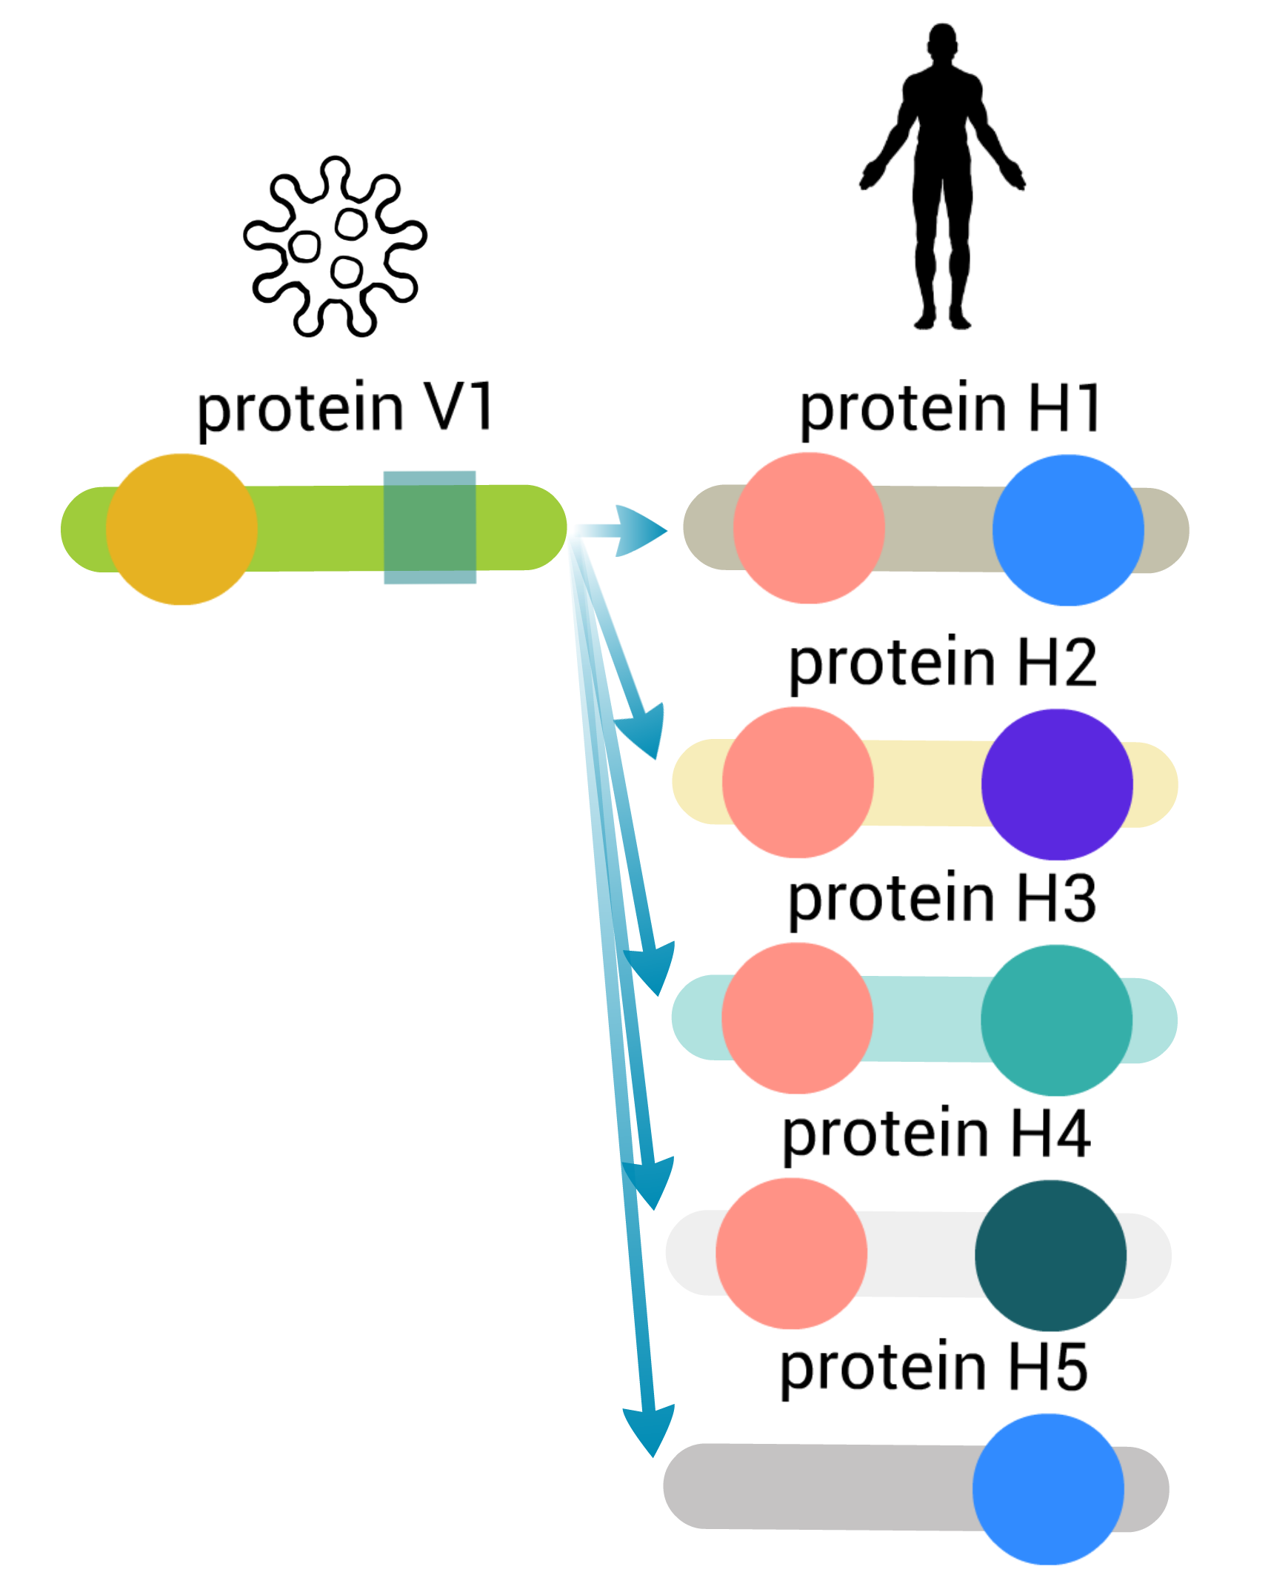



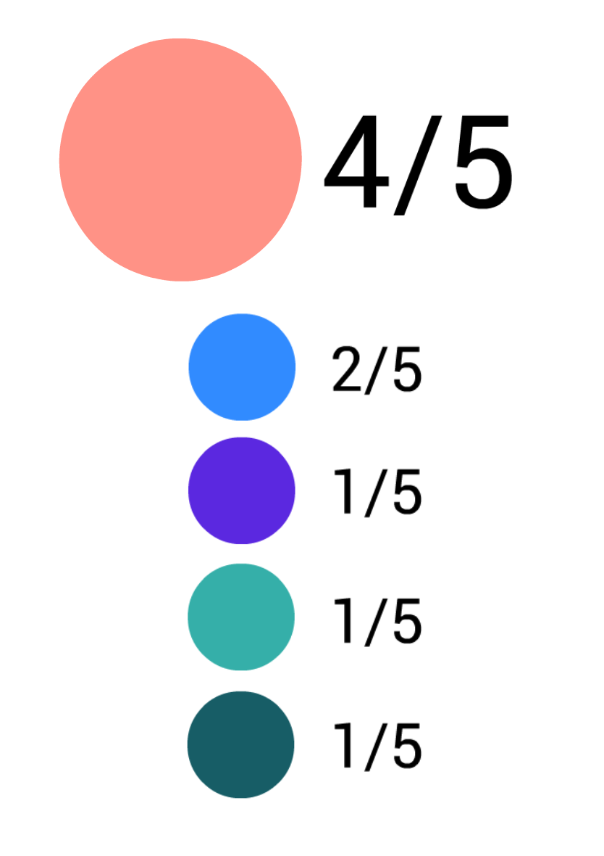

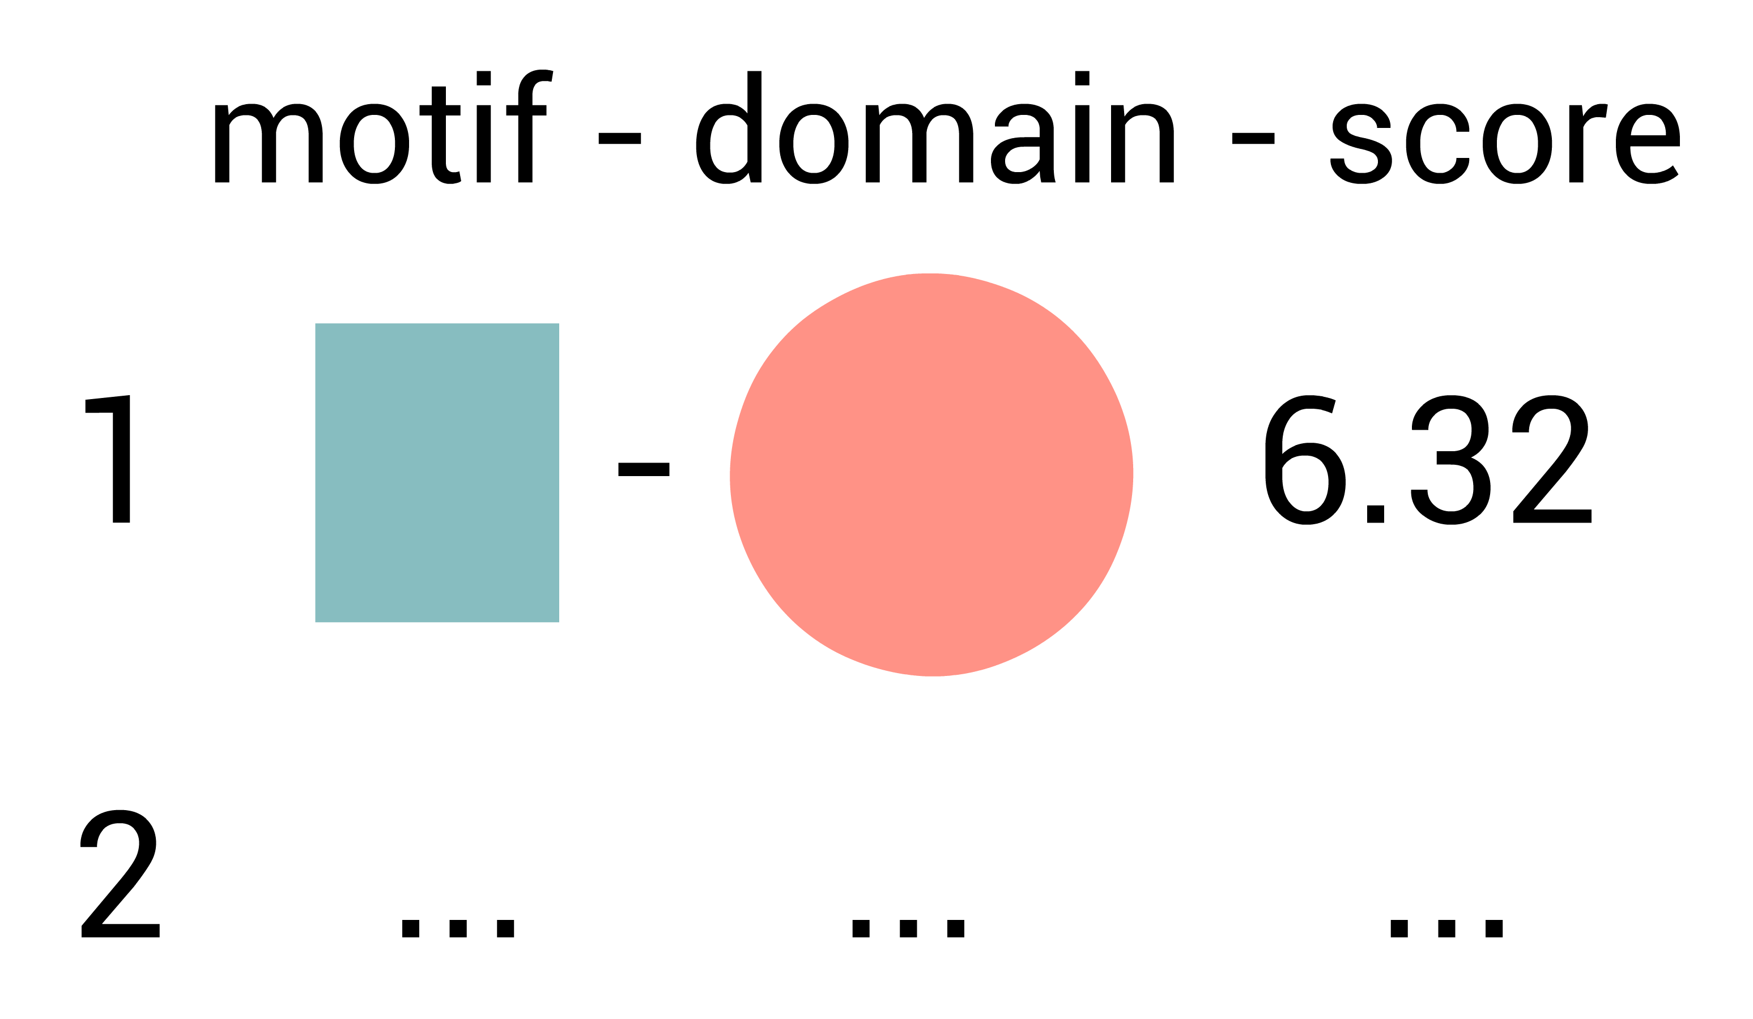
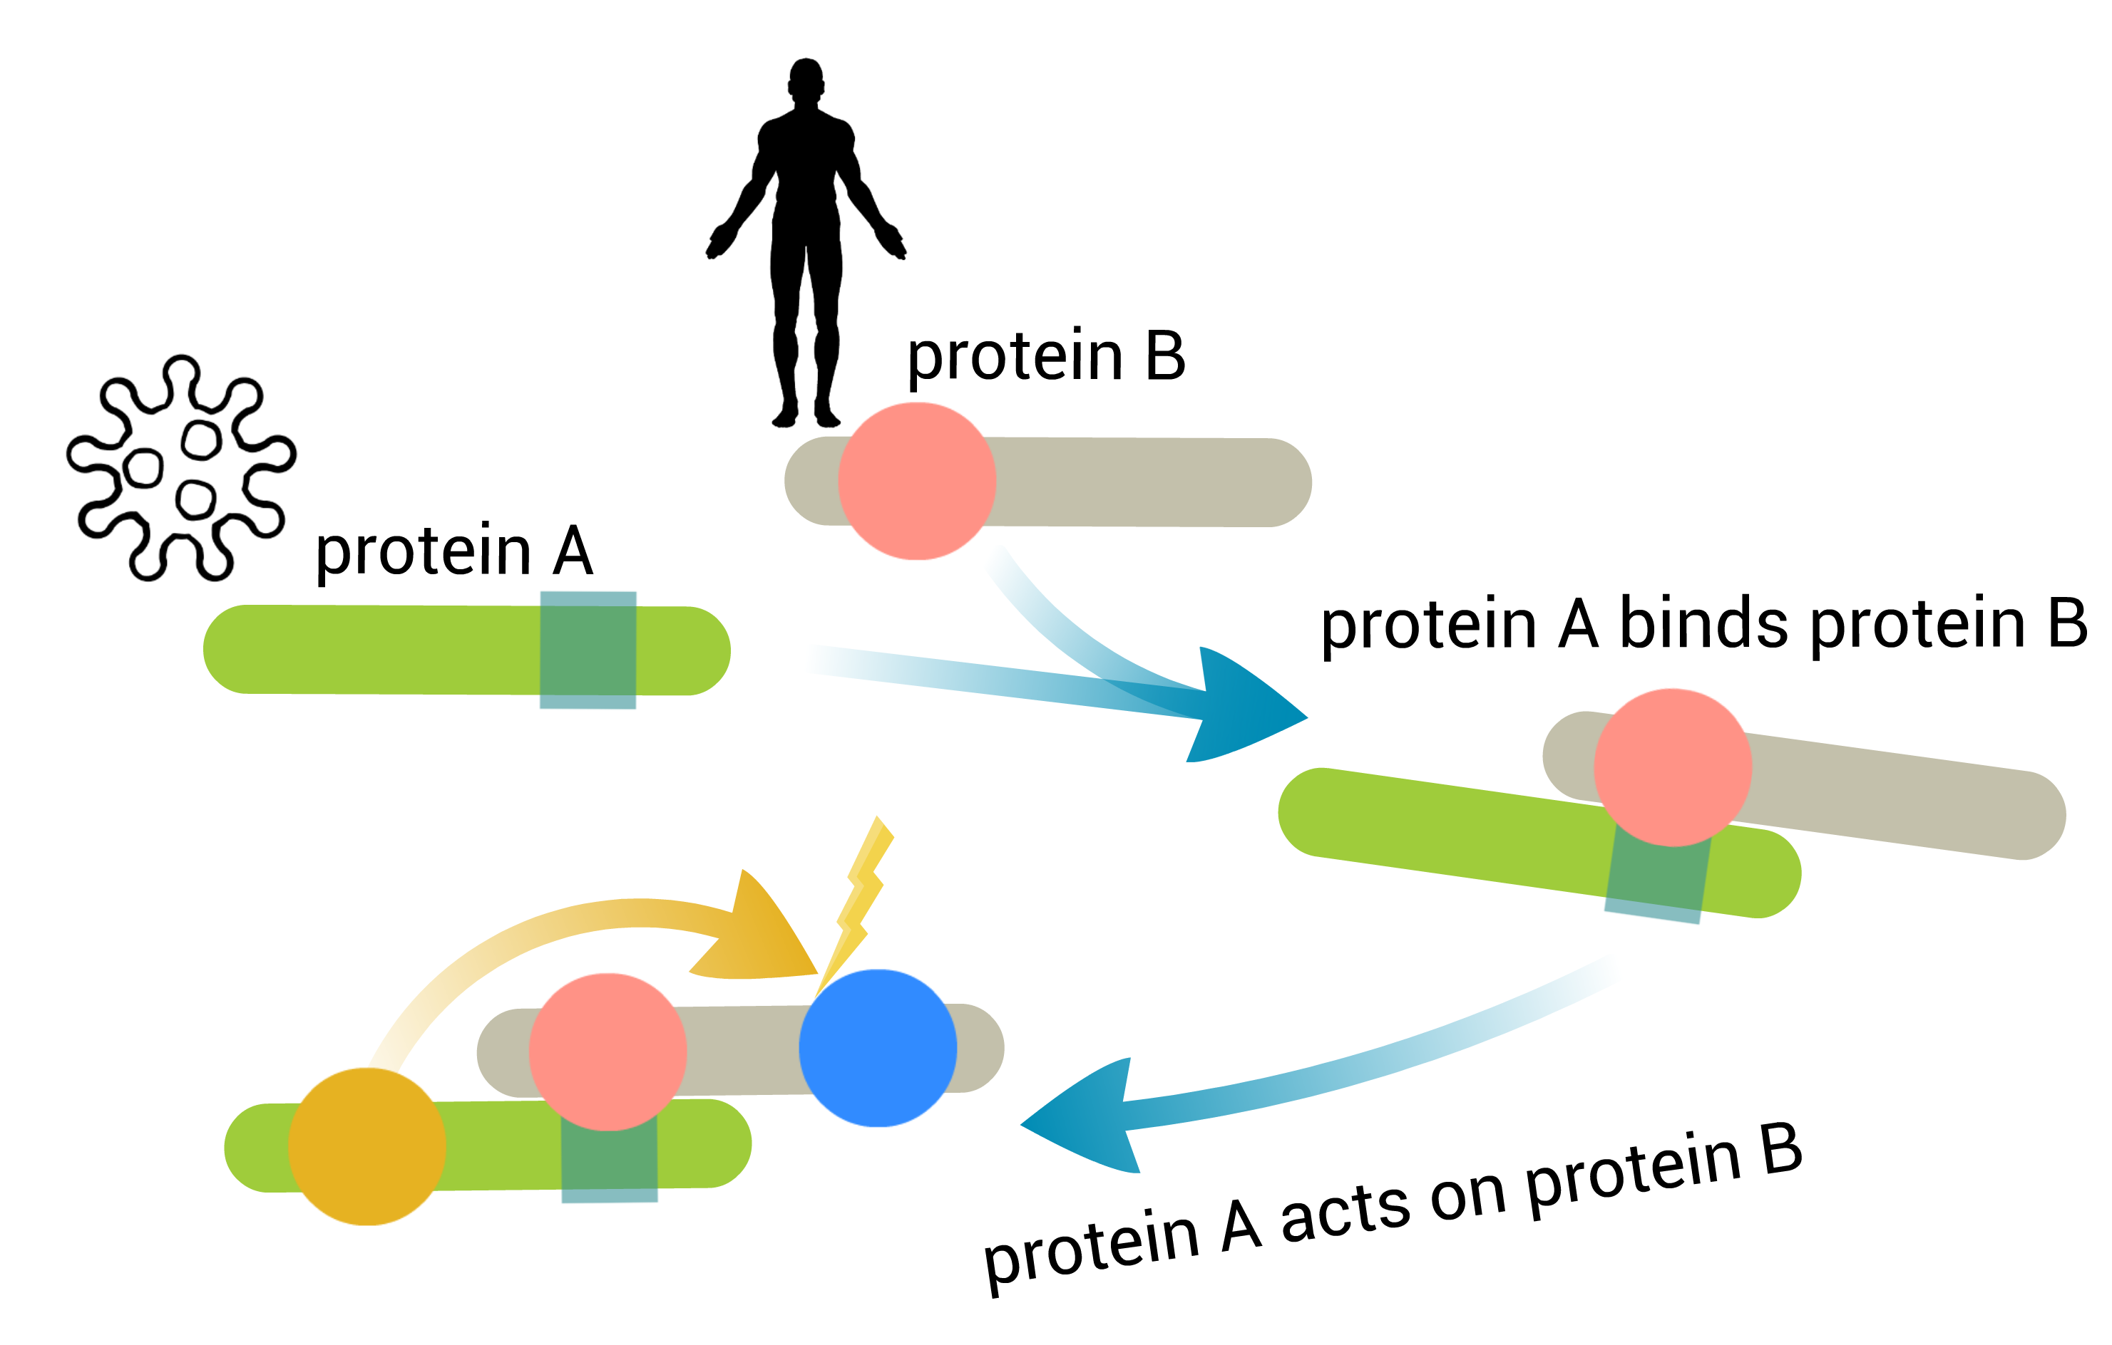
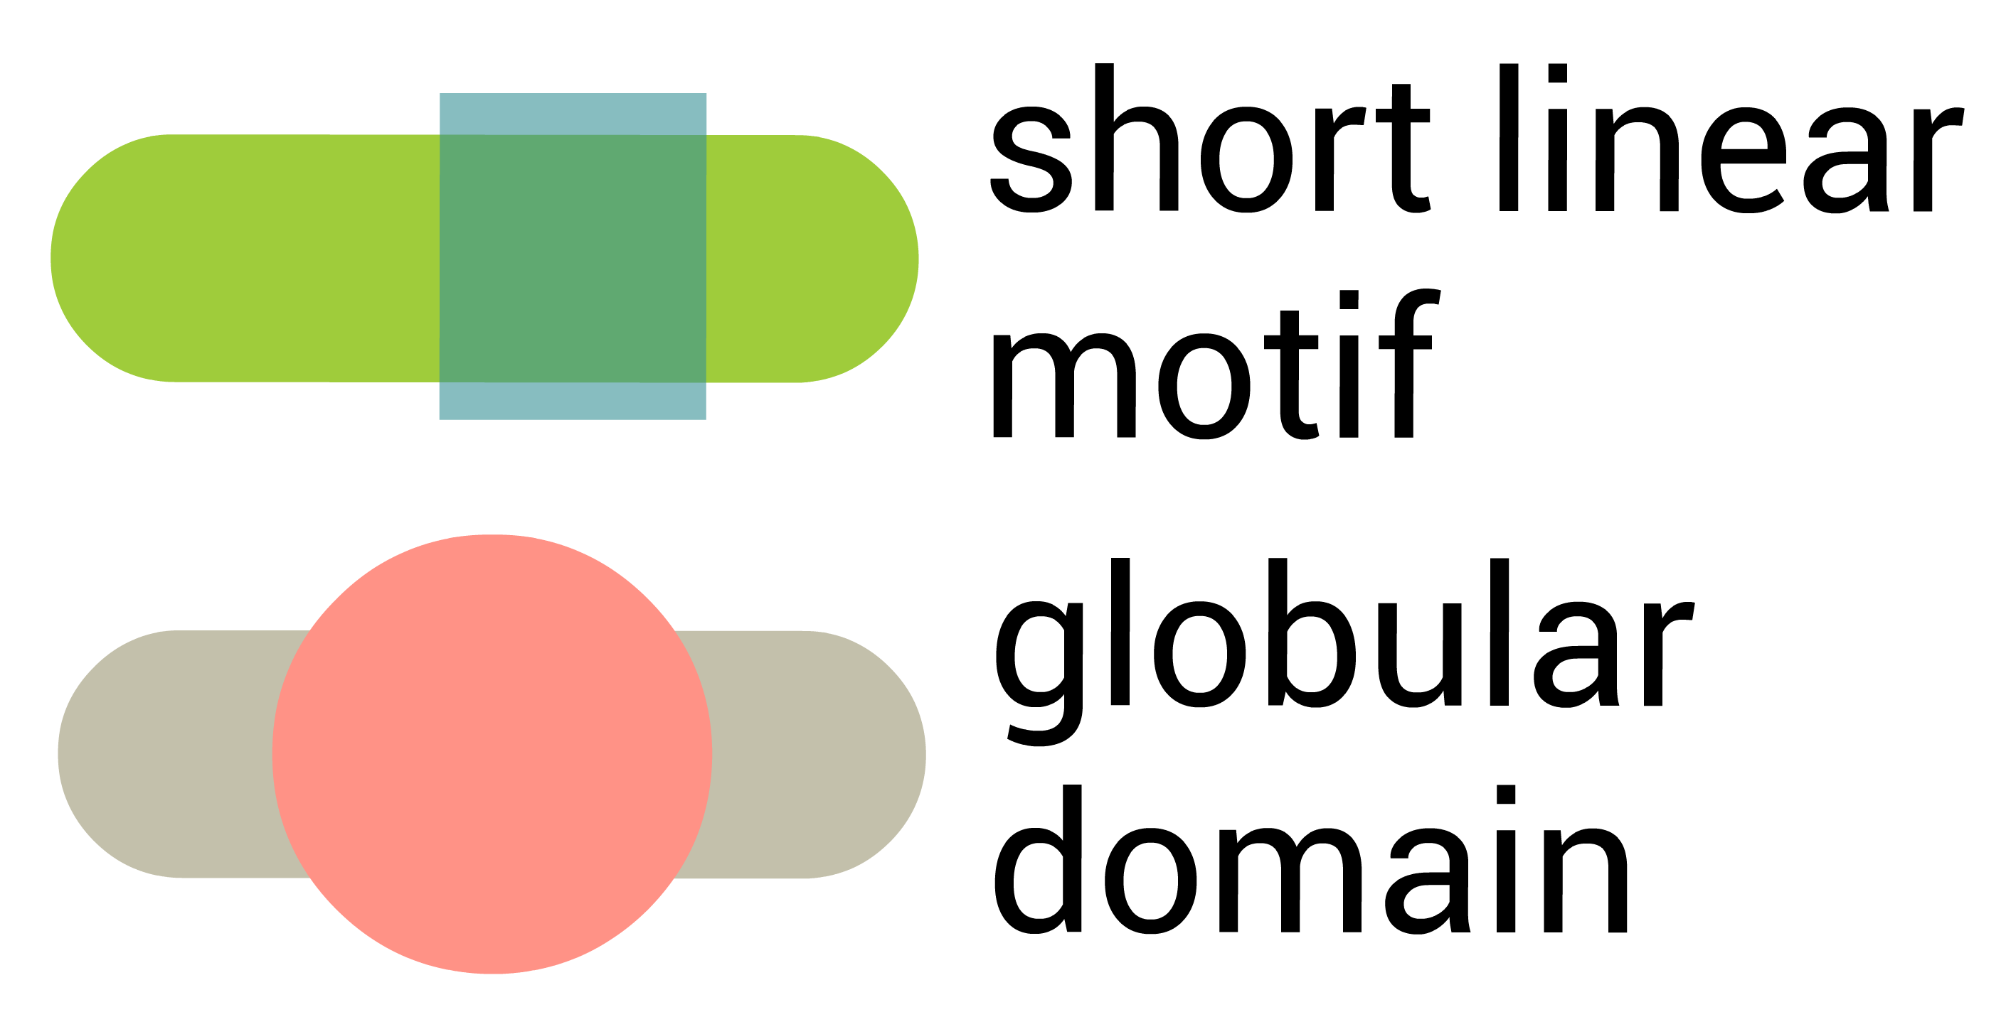
Identifying novel functional linear motifs using host-viral protein interactions and the principle of convergent evolution
Vitalii Kleshchevnikov, Evangelia Petsalaki
EMBL-EBI, whole-cell signaling group
Workflow
Dataset
1
We obtain protein
interaction data from
1
2
1
Experimentally derived protein-protein interaction data
Globular
domains
2
We use to identify
known globular domains
Linear
motif
Viral proteins tend to
have more human
interacting partners than
human proteins have
viral interacting partners.
Viral-interacting human
proteins have more
known interacting
partners than average
human proteins.
motif-domain
pair
3
We estimate which
domains are likely to
mediate interaction
4
We take interacting partners of
every protein that contains these
domains and use QSLIMFinder to discover linear motifs de-novo
3
5
Resulting domain-motif pairs can be compared to known and tested using phage display
2
Domain
features
Scanning protein interaction network
using signatures from InterPro
member databases give us 48096
protein-domain pairs in the full
human-human network (12066 in the
human-viral network)
Linear motif mediated protein interactions
short linear motifs:
3-15 amino acids in length
3-5 defined positions
allow inducible recruitment
extensively involved in cell signaling
6
Future directions
hard to identify functional motifs
4
extensively exploited by viruses
evolve quickly and enable rewiring of host-pathogen interactions
Identify linear motifs de-novo using QSLIMFinder
In addition to viral-human interactions, limit search space using binding region annotations from IntAct
Compare viral proteins to other groups of proteins by their ability to help identify known domains and motifs
Annotate potential meaning of viral-human domain-motif interaction
Results
5
3
Domains in human proteins that
are likely to mediate interaction
To estimate which domains in human
proteins are likely to mediate interaction
we have calculated the number of
domains (domain count) and the domain
frequency among interactors of a viral
protein, Fisher test p-value for the
overrepresentation of a specific domain
among interactors of a viral protein and
the frequency of viral protein per domain.
We have permuted protein interactions
along viral – human interface to estimate
how likely these values are to be
observed if viral proteins had random
human interacting partners.
Summary
Viral-host interactions rely extensively on linear motif mediated interactions
Rich viral-human protein interaction data can allow identifying domain- motif pairs
Domains in human proteins that are likely to mediate human-viral interactions are enriched in domains known to bind linear motifs
We have analysed if the top domain hits identified using our procedure are enriched in domains known to bind linear motifs (from ELM database) by performing overrepresentation Fisher test and compared these to selecting viral protein – human domain pairs at random
References:
All analyses were performed in R. IMEx consortium databases such as IntAct, MINT, DIP, BHF-UCL, MPIDB, MatrixDB, HPIDb, I2D-IMEx, InnateDB-IMEx, MolCon, UniProt, MBInfo are currently integrated into IntAct [1].
1. Orchard S, Ammari M, Aranda B, et al. The MIntAct project—IntAct as a common curation platform for 11 molecular interaction databases. Nucleic Acids Research. 2014;42(Database issue):D358-D363.
2. Jones P, Binns D, Chang HY, et al. InterProScan 5: genome-scale protein function classification. Bioinformatics (Oxford, England). 2014;30(9):1236-1240
3. Palopoli N, Lythgow KT, Edwards RJ. QSLiMFinder: improved short linear motif prediction using specific query protein data. Bioinformatics (Oxford, England). 2015;31(14):2284-2293
4. Pawson T, Gish GD, Nash P. SH2 domains, interaction modules and cellular wiring. Trends in Cell Biology. 2001;11(12):504-511
5. Hagai T, Azia A, Babu MM, Andino R. Use of host-like peptide motifs in viral proteins is a prevalent strategy in host-virus interactions. Cell Reports. 2014;7(5):1729-1739
6. Edwards RJ, Palopoli N. Computational prediction of short linear motifs from protein sequences. Methods in Molecular Biology (Clifton, N.J.). 2015;1268:89-141

